Slide 1
UTA Case Competition
Team UTDMavs-
Members:
Manish Kumar Aggarwal
Priyash Maini
Shubham Murari

Slide 2
We are a team of highly motivated self-driven individuals from the University of Texas at Dallas. We are Business Analytics grads with a knack of solving complex problems and data analysis.
.
Manish K. Aggarwal
A Business Analytics graduate student equipped with 6 years of experience in Business Process designing and Requirement gathering from business user and converting them into technical specifications.
Priyash Maini
Currently pursuing master’s in Business Analytics from The University of Texas at Dallas. A Certified MapR Hadoop Developer. Iron willed and inquisitive individual.
Shubham Murari
A passionate problem solver and the ‘Why’ question resolver ! A self motivated, goal-oriented person. Excellent storyteller with remarkable business communication skills.

Slide 3
Understanding of Problem Statement and Our Findings:
As per the given information we were supposed to analyze home decor product success based on following factors:
Product Attributes
Social Media and Online Reviews

Slide 4
Product Attributes:
Quartile: Higher value of quartile means product is more successful. e.g. 1 = Worst, 2 = Good, 3 = Better, 4 = Best
Count of Big Transactions: As per our interpretation and machine learning model (Decision Tree & Random Forest) it is a significant variable and it is a determining factor behind the quartile wise classification of products.
Color: As per our analysis (Tableau), people tend to buy multi colored products as compared to the plain ones e.g. white, red, blue etc.
Dimensions(Weight, Width, Height & Depth): When combined together these dimensions explain about 20% of the variation in the data.

Slide 5
..continued
SKU & Product Name: In the field of inventory management, a stock keeping unit is a distinct type of item for sale. It is also an important variable of interest in our data and Product Name is also equally associated with it.
Country of Origin: We have different countries where the product is getting manufactured it plays important role. We will have clear idea of that with the help of visualization.

Slide 6
Social Media and Online Reviews:
Sentiment: To find the overall sentiment of user’s comments – we did some feature engineering by using textblob library in Python. For this analysis we used the information from ‘text’ variable.
Average Rating: We analyzed it by grouping the data as per the quartiles and get the ratings of the products in the individual Quartiles.
Review Count: As per our findings and analysis higher the reviews means the product will be more successful.
Comment, Answers and Question Count: These variables also contribute to the category and success factor of the product, basically more information in these variables shows that the product tend to be more successful.
User ID, Name, Title, Date: We did not consider these variables because they was no correlation and along with that more than 50% values were null collectively.

Slide 7

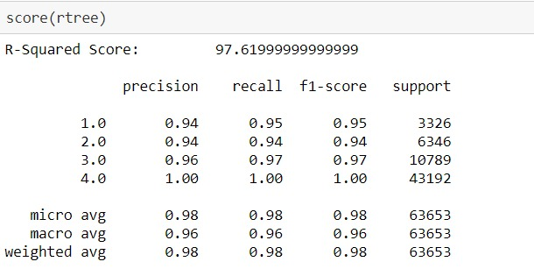
R-Squared & Precision- Recall Matrix:
R squared Value: 97.6 %
For all the classes F1 score is above 95%

Slide 8
Our Findings and Question Answers:
Question
Answers

Slide 9
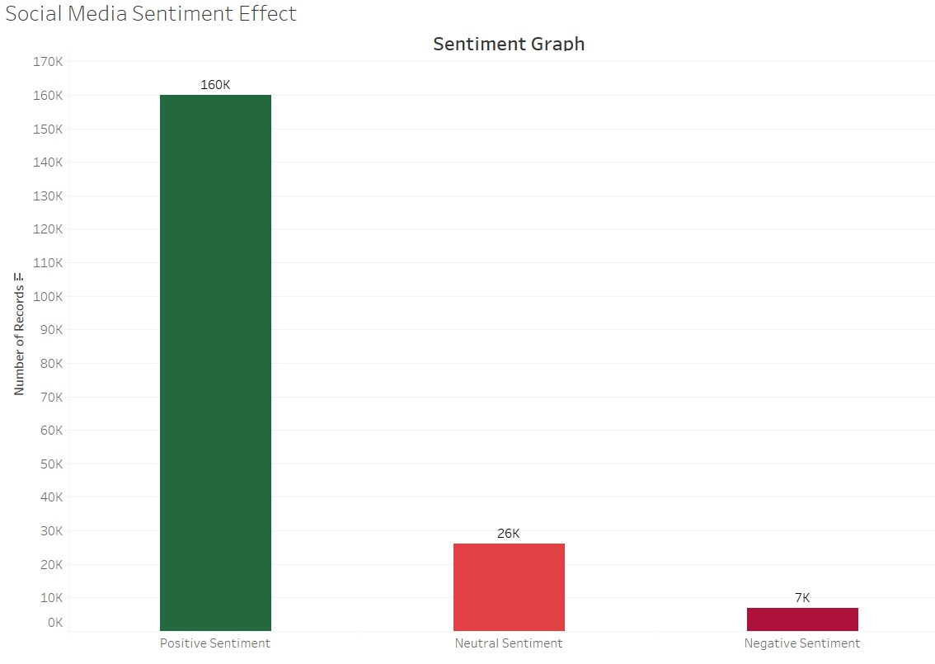
1. What effect if any, does social media sentiment have?
On the basis of SOCIAL MEDIA SENTIMENT ANALYSIS and as per the visualization we got from Tableau, around 160K records have positive sentiments.
And 7K products got negative sentiments.
26K are Neutral.
So basically we can say that as per the given info the data is slightly biased towards Positive Sentiment.

Slide 10
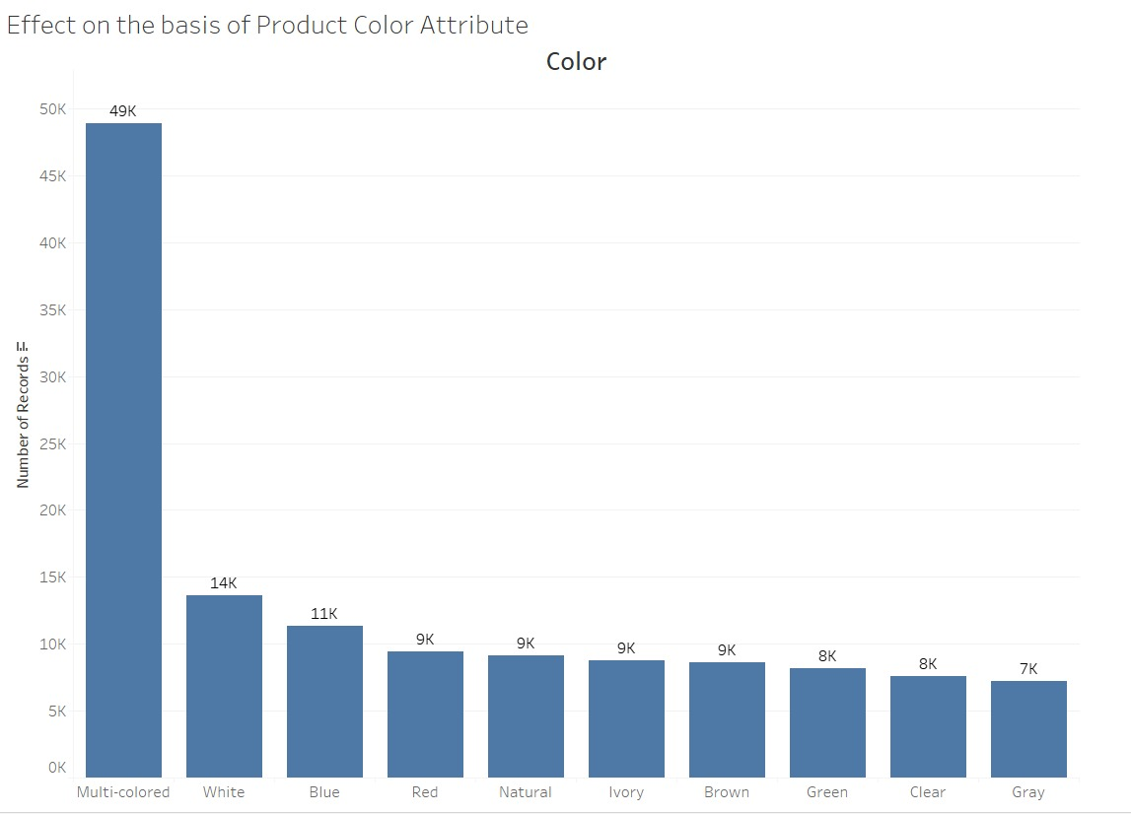
2. What effect if any, do the product attributes (size, color, material, style, etc.) have?
As per our analysis (Tableau), people tend to buy multi colored products as compared to the plain ones e.g. white, red, blue etc.
Dimensions(Weight, Width, Height & Depth): When combined together these dimensions explain about 20% of the variation in the data.
And for other variables like Style, Material etc. the data was insufficient.

Slide 11
3. What home décor products on the broader market are successful and why?
Market1: Furniture Décor.
Market 2: Kitchen Décor.
Market 3: Lights and Candles Décor.
Market 4: Living Space Décor.
Market 5: Miscellaneous.

Slide 12
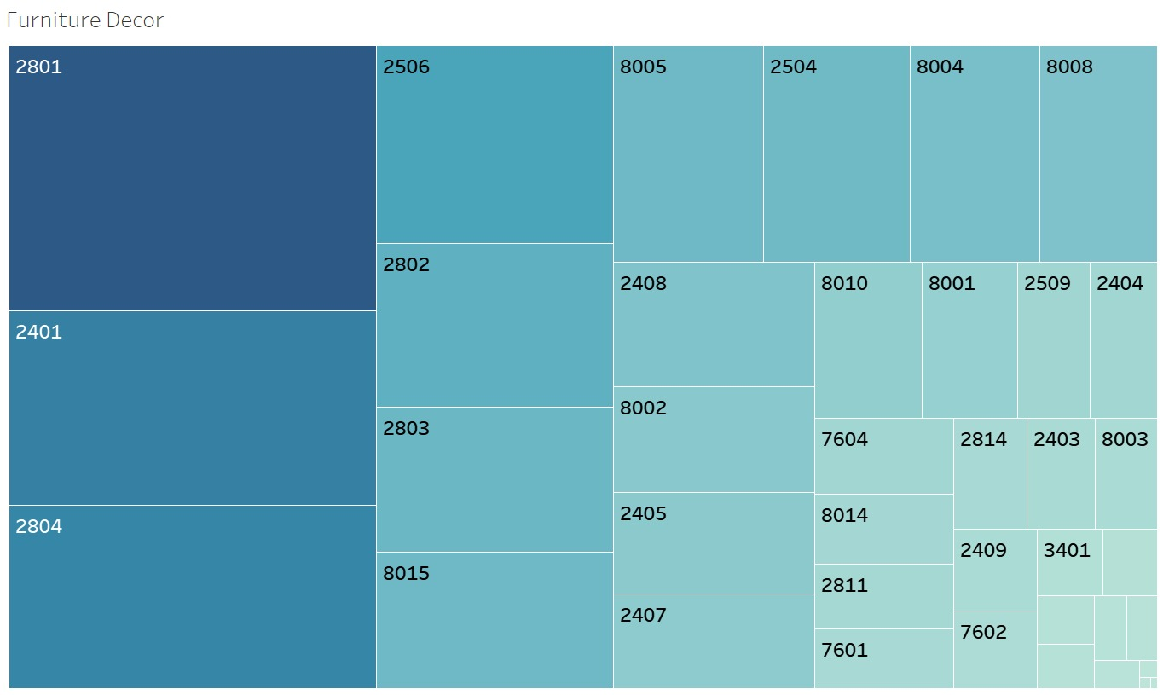
Market 1: Furniture Décor
Among 5 broader markets for Home Décor products following is the chart of class ids for furniture décor.
2801, 2401 and 2804 are most successful products in this market.

Slide 13
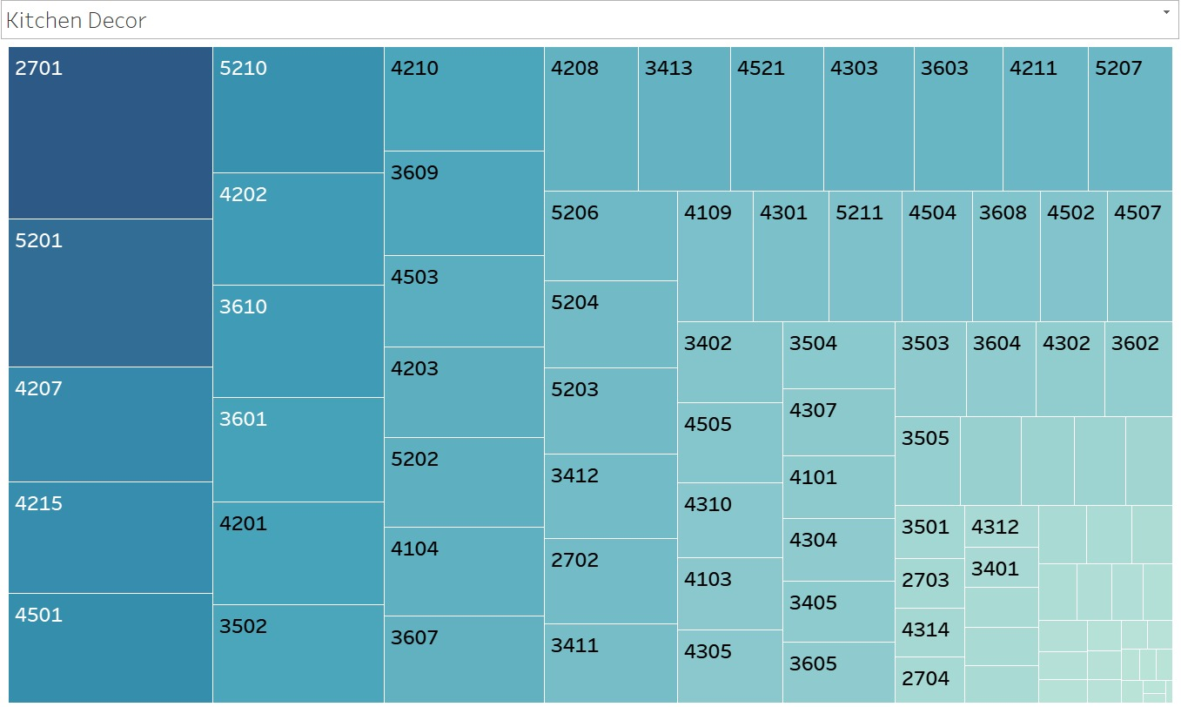
Market 2: Kitchen Décor
Among 5 broader markets for Home Décor products following is the chart of class ids for kitchen décor.
2701, 5201 are most successful products in this market.

Slide 14
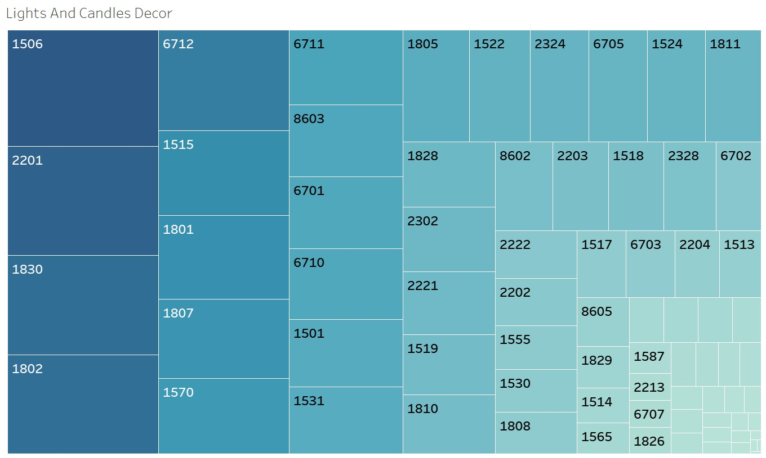
Market 3: Lights and Candles Décor
Among 5 broader markets for Home Décor products following is the chart of class ids for lights and candles decor
1506, 2201, 1830, 1802 are most successful products in this market.

Slide 15
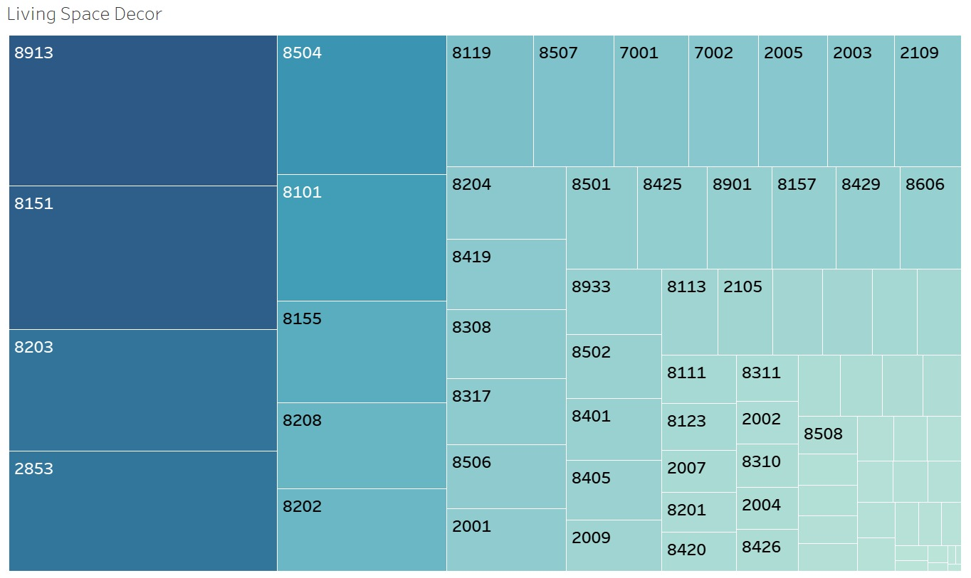
Market 4: Living Space Décor
Among 5 broader markets for Home Décor products following is the chart of class ids for living space decor
8913, 8151, 8203, 2853 are most successful products in this market.

Slide 16
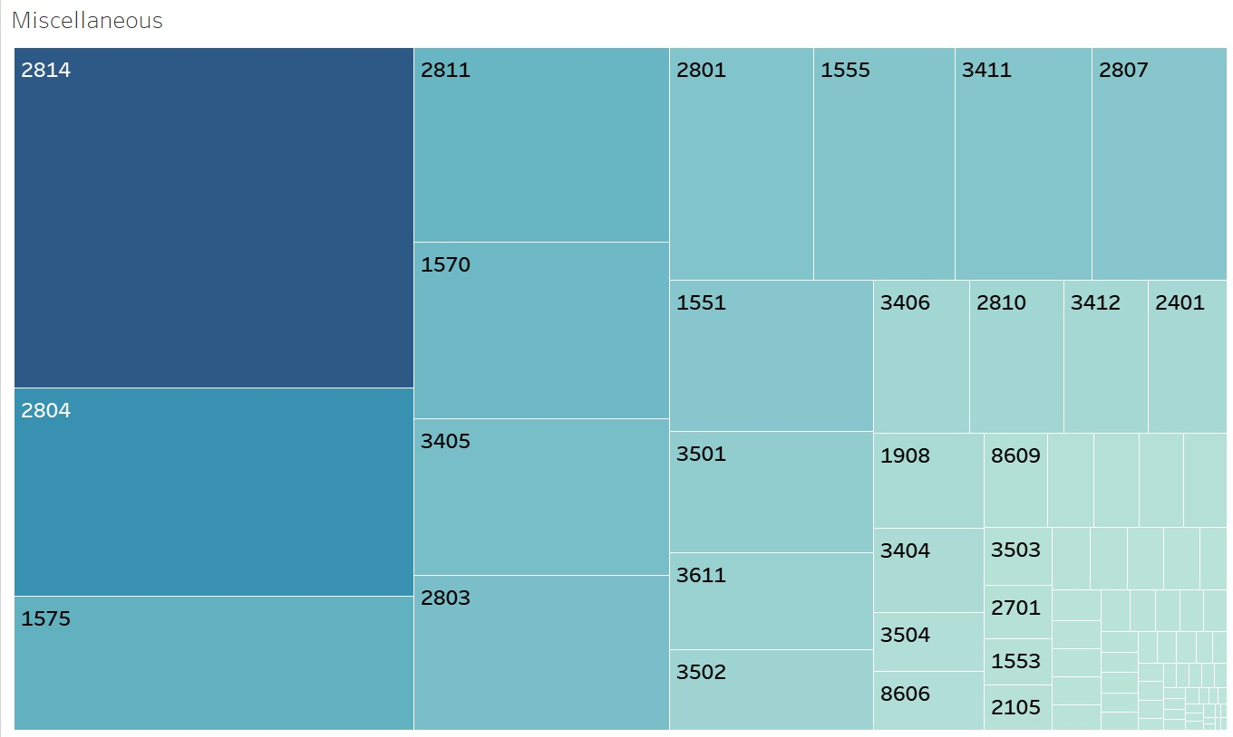
Market 5: Miscellaneous
Among 5 broader markets for Home Décor products following is the chart of class ids for miscellaneous (as they have null values in data so we are classifying them as miscellaneous)
2814,2804,1575 are most successful products in this market.

Slide 17
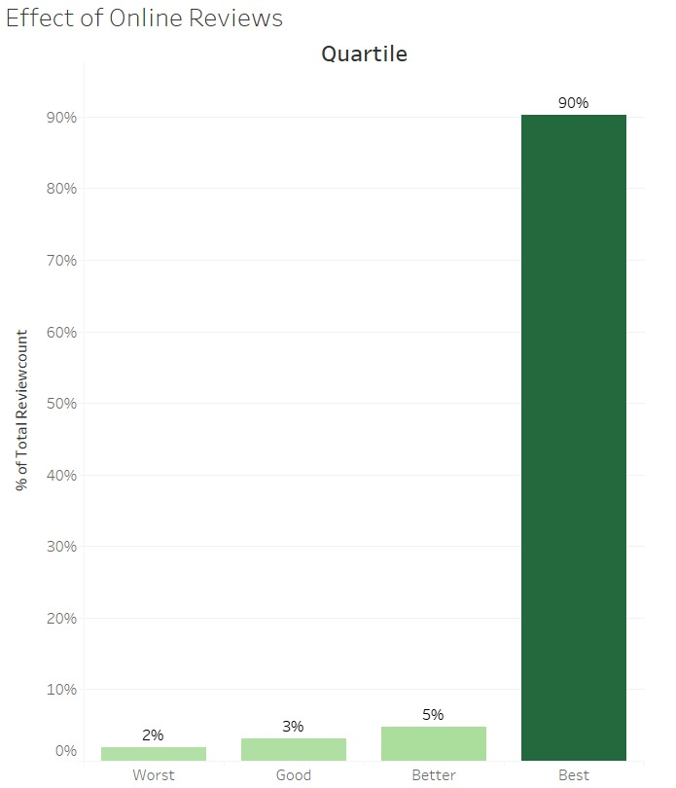
4. What effect if any, do online reviews of the products have?
Online reviews was the most PROMINENT factor in deciding the Product’s Success Rate.
As per our finding and analysis more the number of positive reviews shows that the product will be more successful.
It also explain about 10.5 percent variation in the data.
From the plot 90% of the review counts falls under the 4th quartile which means more review count tend to more successful product.

Slide 18
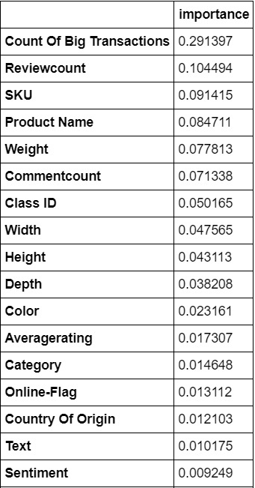
5. What are the attributes of hot selling products in the wider home décor marketplace, both brick and mortar and online?
As per the analysis these variables are the top variables in deciding the success of the product.

Slide 19
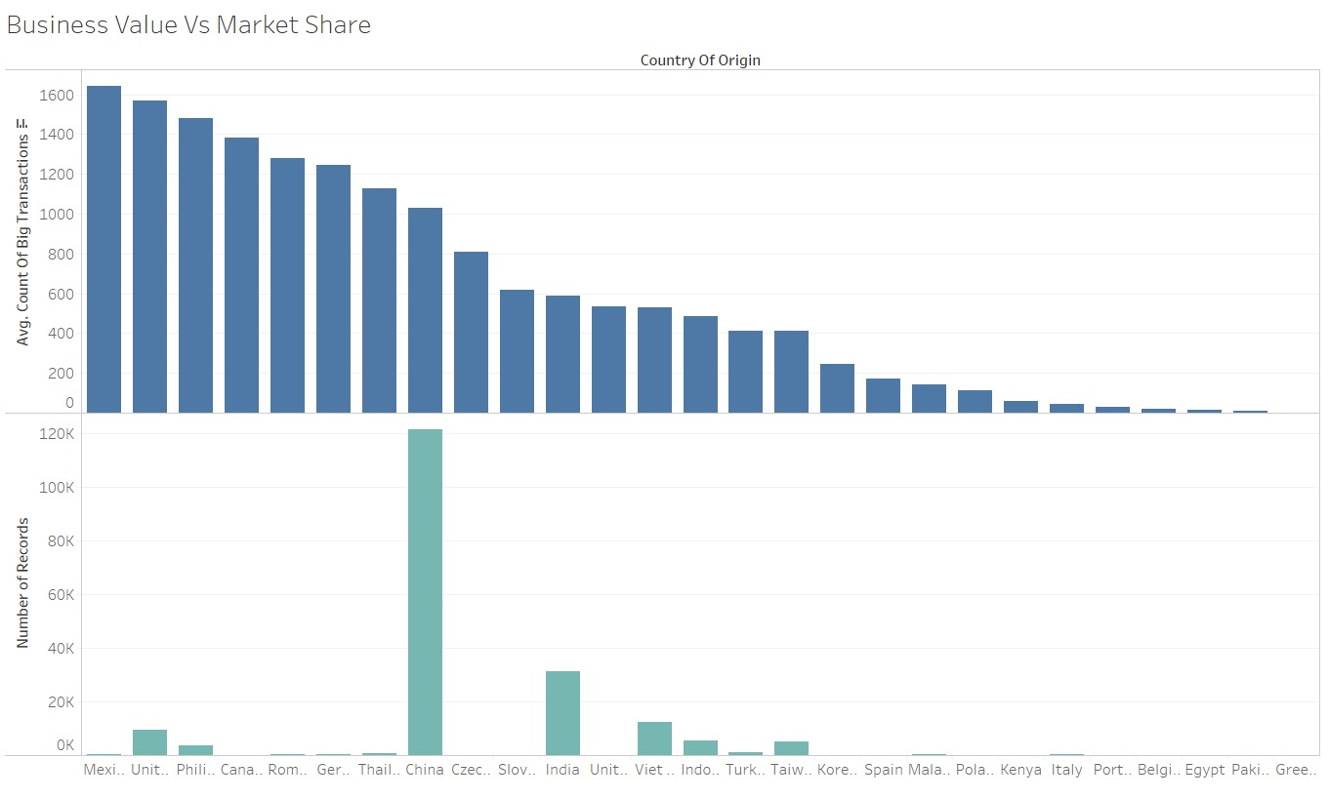
6. Analyze the data for business value from additional perspectives. What didn’t we think to ask?
Although China supplies the maximum amount of the product but Mexico is selling products with the high values thus generating more revenue from the business.
So basically Mexico’s business value is more as compare to China’s.

Slide 20
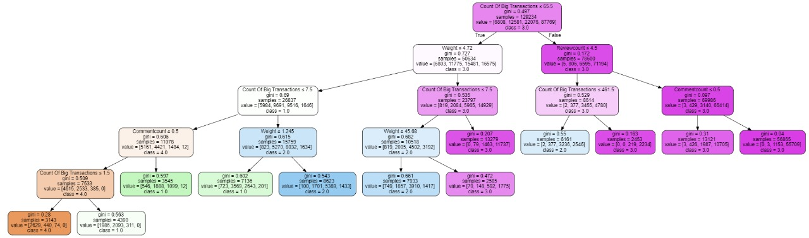
Additional Insights and Visualizations:

